Slide 1
Data Structure
Drawing Editor Project
T1
22102017 Hong Min-ji 23102009 Park Shin-hyung
23102025 Lee Haneol 23102031 Hwang Yu-young

Slide 2
Content
01
Function Introduction
02
Technology Stack
03
Drawing Editor

Slide 3
01
Function Introduction
Basic Functions
Additional Functions
Drawing Tools
Selection Tool
Move a selected shape
Color changing Tool
Grouping
File Save/Load
Undo/Redo

Slide 4



02
Technology Stack
Programing Language
UI Design Tool
Framework
Java
JavaFx Scene Builder
JavaFx

Slide 5
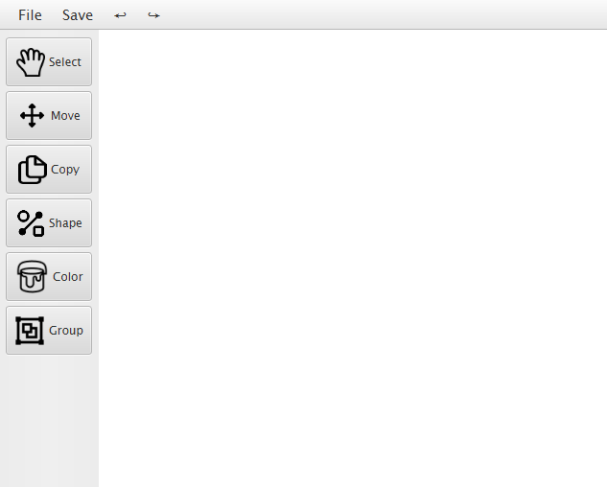
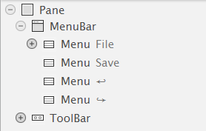
03
Drawing Editor
Main Screen
Our drawing editor have MenuBar and ToolBar

Slide 6
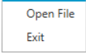
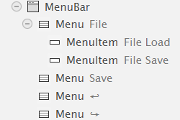
03
Drawing Editor - MenuBar Manual
MenuBar
File Menu Items
(File Load/ Save)
Menu
File Load/ Save
Additional Save menu
Undo/Redo

Slide 7
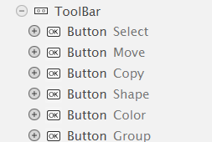
03
Drawing Editor - ToolBar Manual
Select
Click select button ➡️ You can choose copy, color and group
ToolBar
Move
Click move button ➡️ You can move the shape
Copy
Select mode ➡️ Select the shape you want to copy ➡️ Click copy button

Slide 8
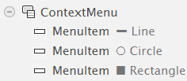
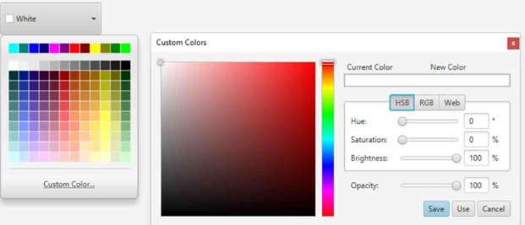
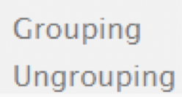
03
Drawing Editor - ToolBar Manual
shape
Click shape button
➡️ You can choose line, circle, rectangle
➡️ Drag on the canvas to draw the shape
ToolBar
color
Select mode
➡️ Click on the shape you want to change the color
➡️ Click shape button
➡️ Choose your desired color from the color palette
group/ungroup
Drag more than two shape ➡️ Click grouping button
Select grouped shape ➡️ Click ungrouping button

Slide 9

Thank You :)
More detailed user manual ➡️

